Slide 1
Data Pilot Projects
Partnerships with Stanford researchers
Develop methods for data preservation, sharing, and discovery
Real-world data ➔ real-word data issues
Assess user needs ➔ services & resources
Researcher receives PURL(s) to share data

Slide 2
SDR Project 0: David Donoho, Statistics
Found SDR based on a Google search
Paper in Proceedings of the National Academy of Sciences (PNAS) beginning of 2013
One .csv file, descriptive metadata in a readme.txt file, and a code file
PURL required immediately for galley proof

Slide 3
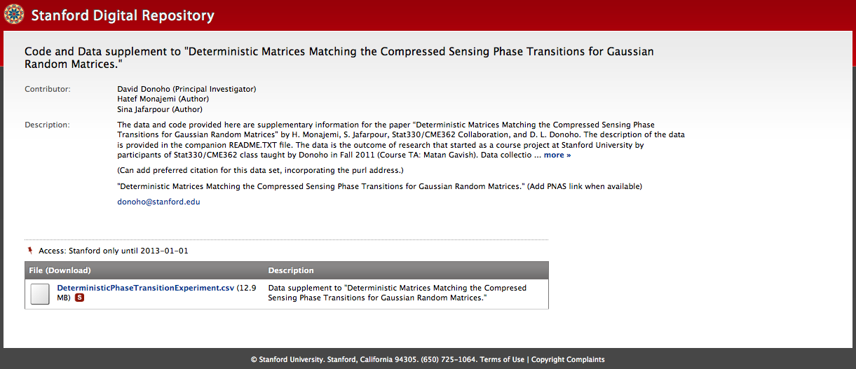
Donoho Test PURL

Slide 4
SDR Project 1: Chris Gerdes, Mechanical Engineering
Development of driver assistance systems: instrumenting car and driver simultaneously
Where the car is > GPS
What the car is doing: engine, suspension, etc.
What the driver is doing: brake, throttle, clutch, steering
Driver physiology: heart rate, respiratory rate, brain wave data
Cameras recording the event > VIDEO
Driver post-race interviews
Notes:
Time-stamped data with measurements, mostly MatLab
MoTech allows syncing with the video

Slide 5
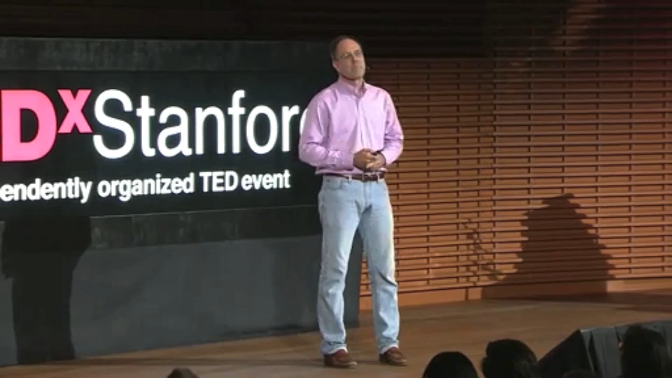
Chris Gerdes TED^{x}Stanford Talk
Notes:
May 2012
One race, one car would be a data set
Sample preliminary data sets from vintage race cars

Slide 6
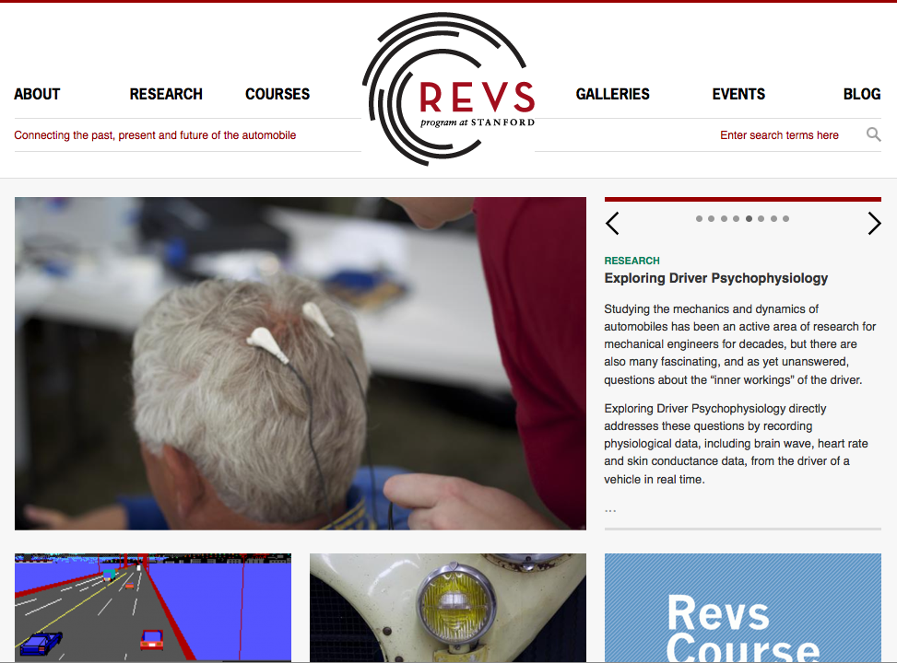
Stanford REVS

Slide 7
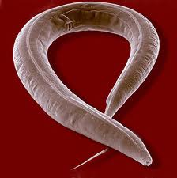
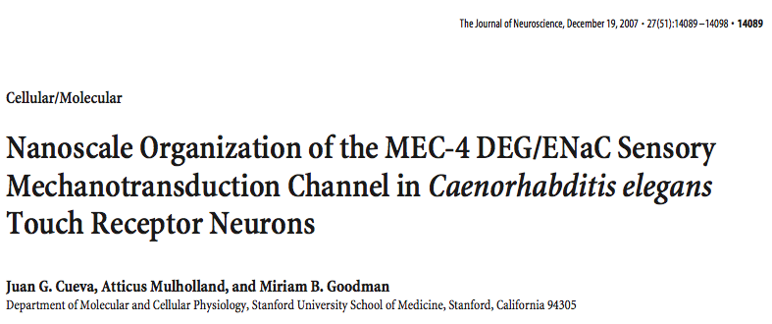
SDR Project 2: Miriam Goodman, Molecular & Cellular Physiology
Sense of touch in C. elegans
Electron micrographs are knowledge-rich, storage- intensive, and hard for people to access
Jürgen Berger & Ralph Sommer,
Max Planck Institute for Developmental Biology
Many more questions could be asked of these images by others

Slide 8
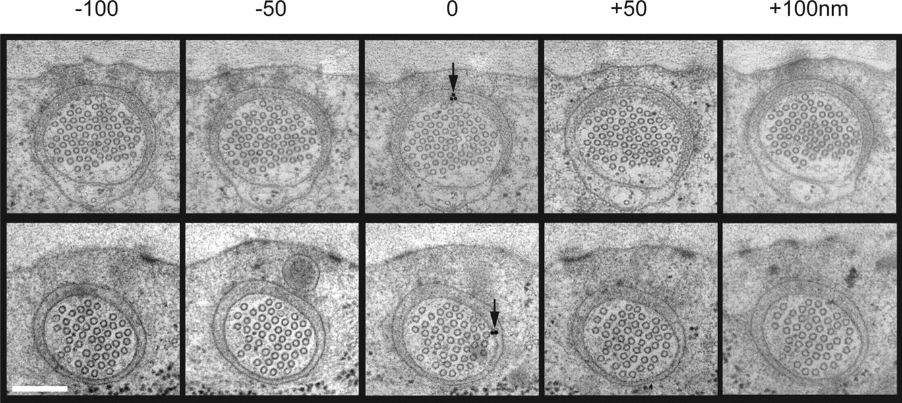

Electron Micrographs of C. elegans cross sections
©2007 by Society for Neuroscience
Cueva J G et al. J. Neurosci. 2007;27:14089-14098

Slide 9
SDR Project 2: Miriam Goodman, Molecular & Cellular Physiology
Each image has two versions: raw and tiff + file for slice reconstruction
Each image is about 15 MB
One set of micrographs can contain 150-400 images
At least 6 data sets that we can work with immediately
Need assistance with metadata schema

Slide 10
In the Queue…
SDR Project 3:
Gretchen Daily, Natural Capital Project
Working to develop a scientific basis for managing Earth’s life-support systems
SDR Project 4:
Mark Musen, Director of the Center for Biomedical Informatics Research, Chair of C-LIB
Components for building knowledge-based systems, controlled terminologies and ontologies, and technology for the Semantic Web
SDR Projects 5+:
Social Science?
Geoscience?
Chemistry?

Slide 11
ask-data-services @lists.stanford.edu
Notes:
If you have data issues, we want to hear from you!

